Slide 1
Cloud Computing Introduction
L09 –Cloud Nine
C273 – Advanced Web Applications Development in PHP

Slide 2

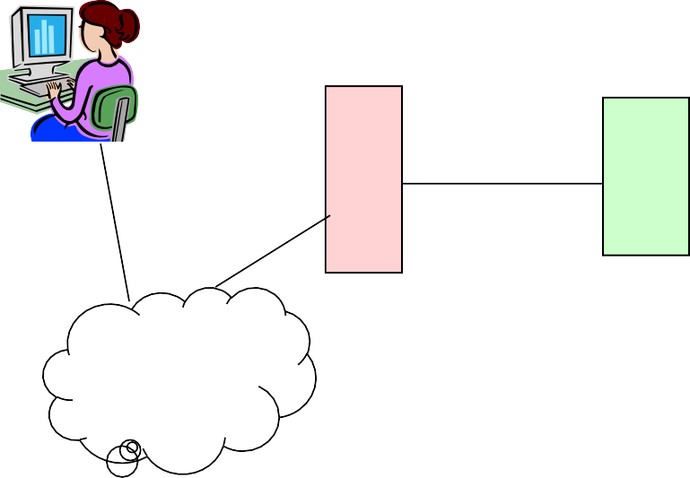
Basic Web Application Architecture
Client/Presentation Tier
Business Tier
Resource Tier
Employee
Database Server
Application Server
Customer
Firewall
Web Server
Data Logic
Business Logic
Internet

Slide 3
What is cloud computing?
It is a service rather than a product.
Can access cloud based applications through a web browser or a light weight desktop/mobile app
No need to install software and high configured machinery.
All you need is INTERNET having good speed.
Service is fully managed by provider.
A simple example of cloud computing is Yahoo, Gmail, Hotmail etc

Slide 4
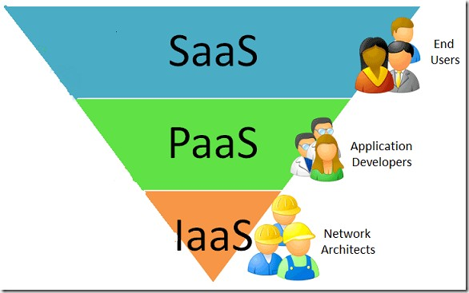
Cloud Service Models
3 Cloud Service Models
Software as a Service (SaaS)
Platform as a Service (PaaS)
Infrastructure as a Service (IaaS)

Slide 5
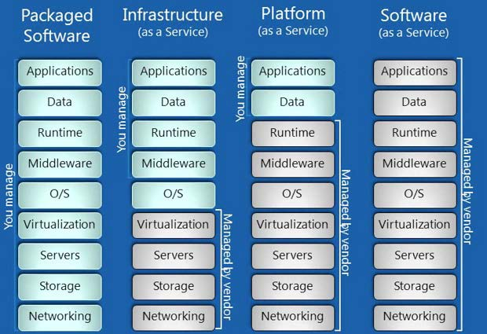
Packaged Software vs Cloud Service Models

Slide 6
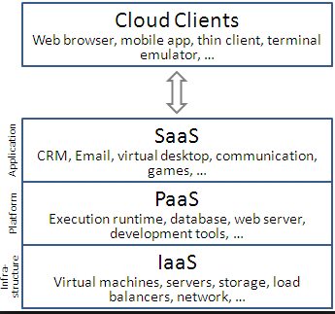
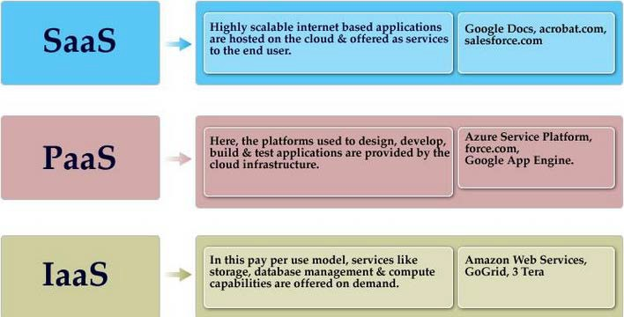
3 Cloud Service Models
Examples of each Cloud Service Model

Slide 7
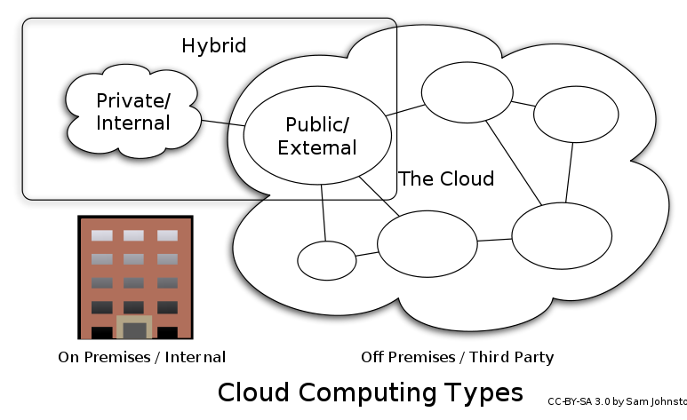
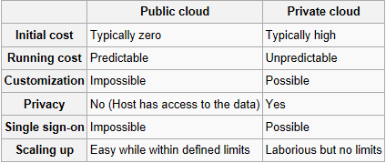
Cloud Deployment Models
3 Deployment Models:
Public Cloud
Private Cloud
Hybrid Cloud
http://en.wikipedia.org/wiki/Cloud_computing

Slide 8
4 Merits of Public Cloud Computing
Pay on usage basis: Pay as you Use only for the resource you use and for the duration you use. E.g. use You will pay only for the time you used a compute instance(server).
Scalability: Instant provision of additional resources as required. Elasticity provision or release resources as per requirement which results in reduced costs.
Availability: resilient systems compared a typical self managed setup. You are able to focus on your core business instead of wasting your maintenance time and energies in running IT.
Low Start-up/Initial cost. You are not burdened with making large capital IT investments.

Slide 9
4 Drawbacks of Public Cloud Computing
Control: Companies have reduced control of their IT systems and are completely dependent on the cloud service providers.
Risks of security and data confidentiality. Companies might not be comfortable handing over their data to a third party. It is usually a big concern for companies to store sensitive information on cloud servers.
Data: Since the resources are shared among different entities in a public cloud , there are higher risks of breaches. Companies may find it very tough and not cost effective to move from one lock- in cloud provider to another if they are not satisfied with the services.
Costs: Costs incurred over longer periods of time (say 5 or more years) may not be any less when compared to having IT systems in-house (having their own data centres where companies host their applications and data on their premises).

Slide 10
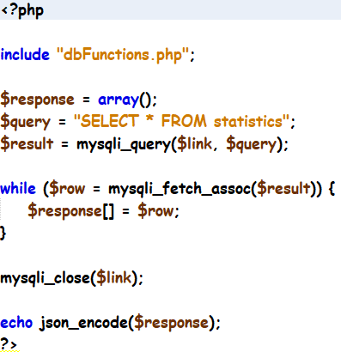
getStatistics.php

Slide 11
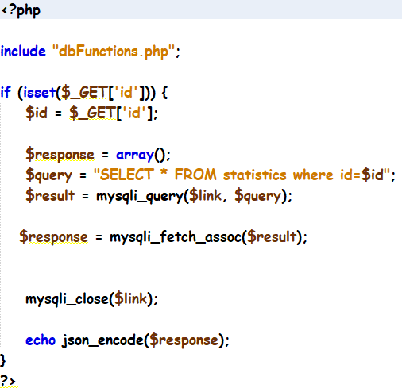
getCountryDetails.php

Slide 12
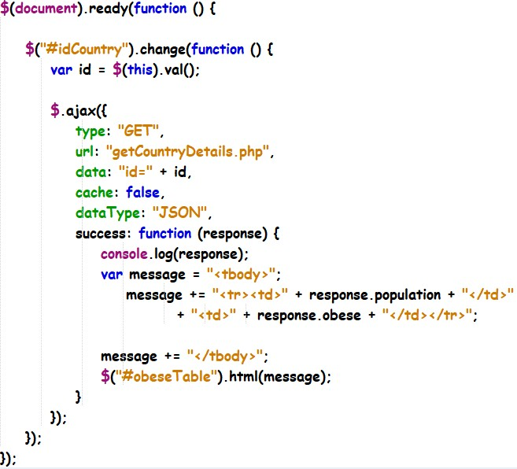
showCountryObese.js

Slide 13
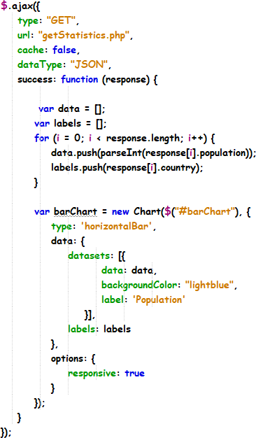
showWorldPopulation.js

Slide 14
Summary
State the advantages and disadvantages of the cloud
State the different types of cloud solutions
Understand the different cloud deployment models
Compare the different cloud solutions for deploying web applications

